Slide 1
Warby parker funnel project
Date: 26th September, 2020
capstone – analyze data with sqL
By– Alpesh patil

Slide 2
Table of contents
About the dataset
What is funneling? Concepts related to A/B Testing
Question wise analysis of data
Basic understanding of the data
Quitters at each question
Quitters at each question – Analysis
Rest of the tables
Unique requirements
Additional in-depth Analysis(To be updated)

Slide 3
About the Company
Warby Parker was founded with the sole objective: to offer designer eyewear at a revolutionary price, while leading the way for socially conscious businesses.
They follow a single motto – Good eyewear, good outcome.

Slide 4
About the datasets
In this project, different Warby Parker’s marketing funnels were analysed in order to calculate conversion rates. Here are the funnels and the tables that were provided:
Survey
Quiz
Home_try_on
Purchase

Slide 5
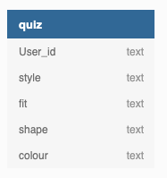
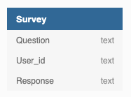
About the datasets
Survey
Question – The marketing questions
User_id – The user id tracked of the customer
Response – Answers collected for each question
Quiz
User_id – The user id tracked of the customer
Style – The user id tracked of the customer
Fit – Type of fit(S, M, L)
Shape – Rectangular/Squarish/Circular
Colour – Colour of the frame

Slide 6
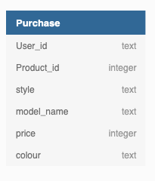
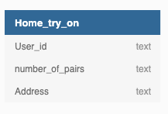
About the datasets
Home_try_on
User_id – The user id tracked of the customer
Number_of_pairs – Number of pairs taken to try at home
Address – Address entered by the user
Purchase
User_id – The user id tracked of the customer
Product_id – Tracker id of the product purchased
Style – Style of the frame
Price – Price of the frame
Colour – Colour of the frame bought

Slide 7
What is funneling? What is an a/b test?
A conversion funnel in e-commerce illustrates the route your customers take from first becoming aware of your brand to making a purchase.
Every business has a different e-commerce conversion funnel depending on the specifics of how users navigate their businesses. The stages are the same, but the specifics depend on your product and audience.
For instance, some businesses have shorter conversion funnels. When you sell a low-cost product, you can convert visitors faster because price becomes less of an obstacle.
Credits to: https://sleeknote.com/blog/e-commerce-sales-funnel
A/B testing (also known as split testing) is a comparison of two variations of the same product shown to two different target samples(of the same population) at the same time so as to compare which variation drives more comparisons.
Credits to: https://vwo.com/ab-testing/

Slide 8
Answers for every query and brief description

Slide 9
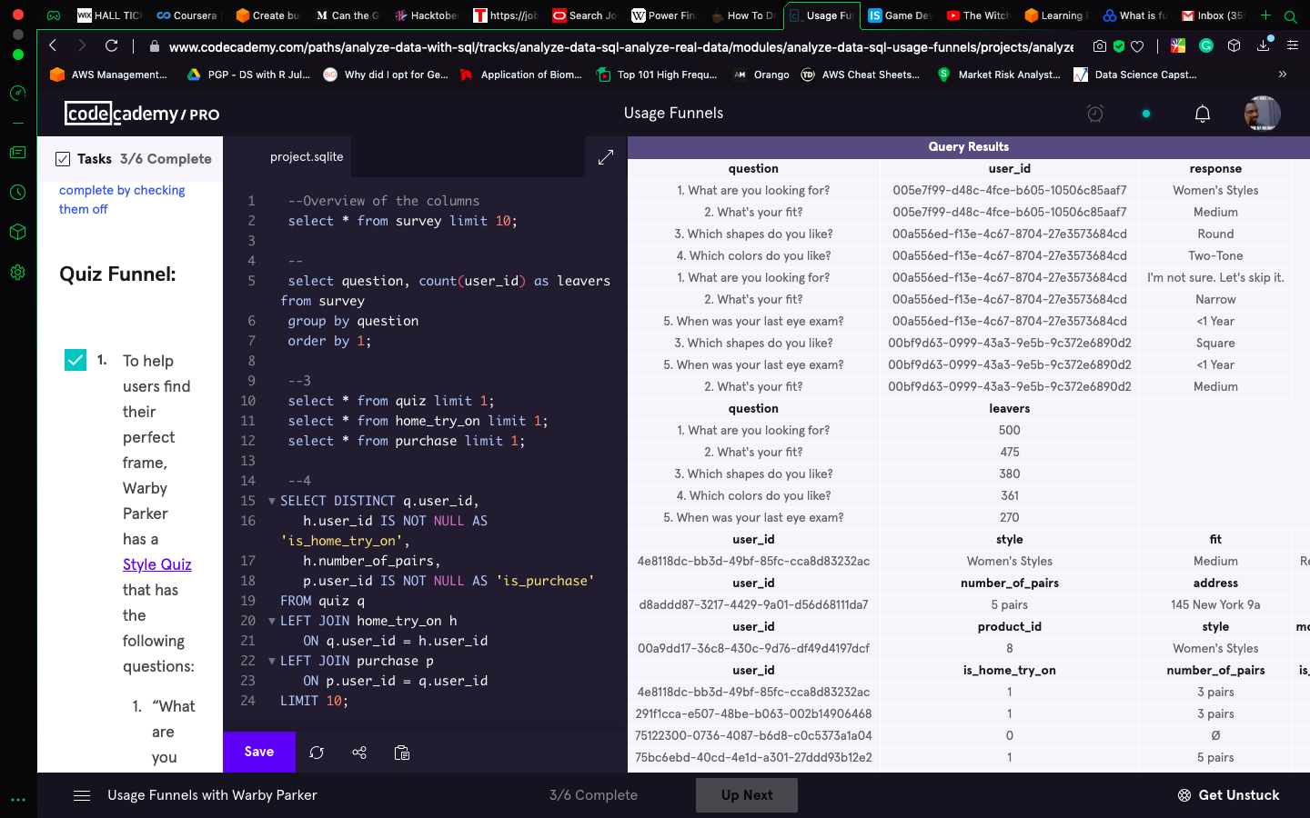
Query 1 – basic understanding of the data
Style quiz answers for every user id and a basic understanding of the data in the table ‘survey’.
SELECT * FROM survey LIMIT 10;
A small overview of the data – column name, data type of the values

Slide 10
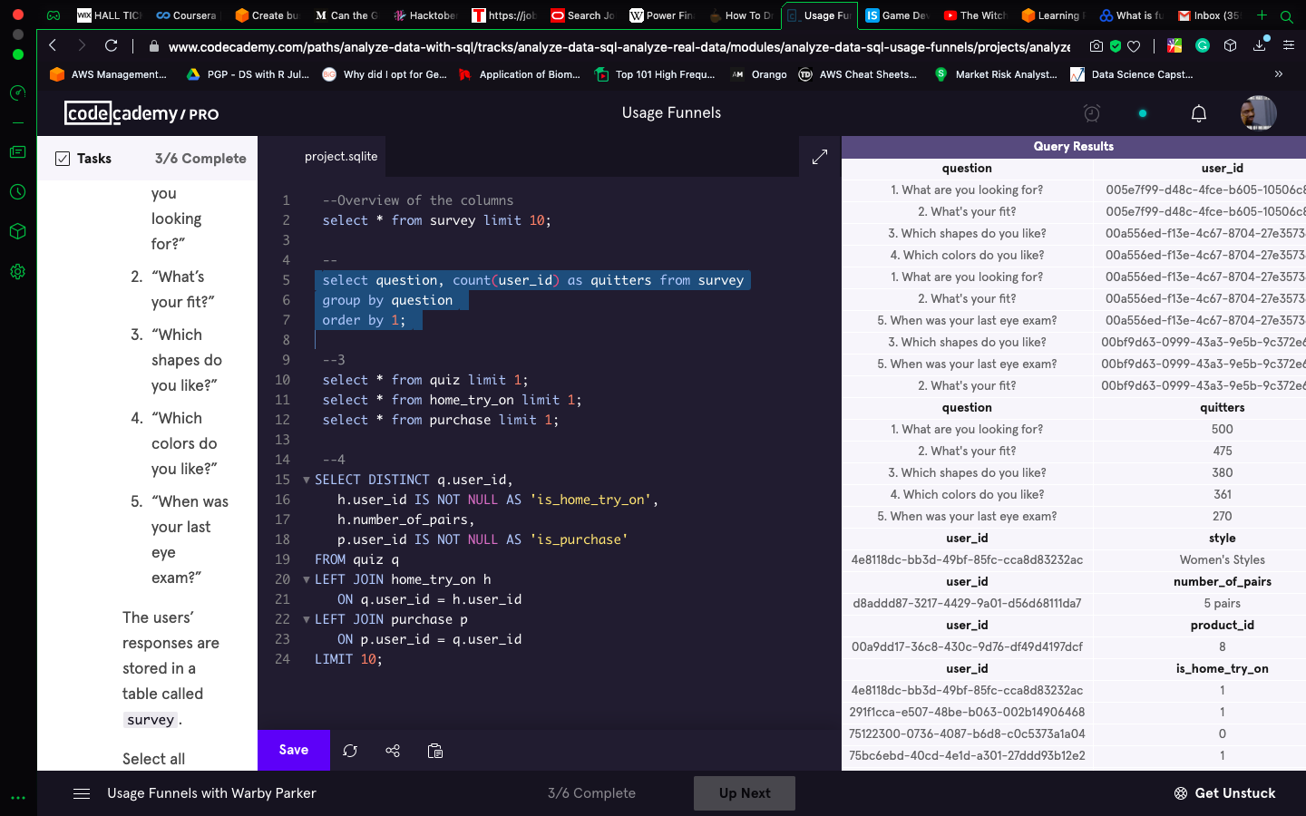
Query 2 –quitters at each question
SELECT question, COUNT(user_id) AS quitters FROM survey GROUP BY 1 ORDER BY 1;
By selecting the question from the survey table and counting the number of user_id per question, we can find the number of people who had left after every question.

Slide 11
Query 3 – quitters at each question - Analysis
question | Quitters | Percentage | Percentage Drop
1. What are you looking for? | 500 | 100% | 0%
2. What's your fit? | 475 | 95% | 5%
3. Which shapes do you like? | 380 | 76% | 24%
4. Which colors do you like? | 361 | 72% | 28%
5. When was your last eye exam? | 270 | 54% | 46%
100% of the target population had attempted the first question and clearly the number of people attempting the next question and the next question started to drop significantly
At the end, only a little over 54% of the target population answered the final question

Slide 12
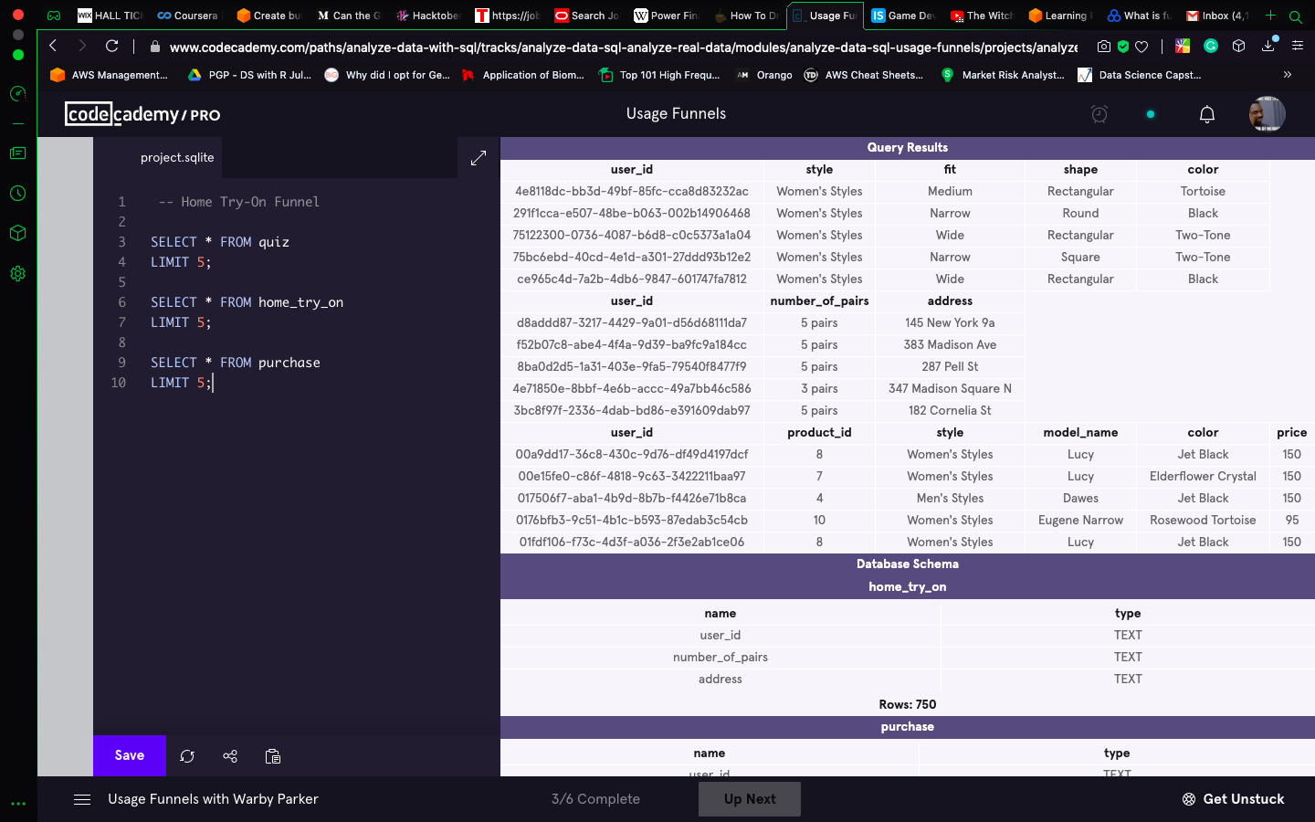
Query 4 – rest of the tables
SELECT * FROM quiz
LIMIT 5;
SELECT * FROM home_try_on
LIMIT 5;
SELECT * FROM purchase
LIMIT 5;
A small overview of the data in the other 3 tables – column name, data type of the values

Slide 13
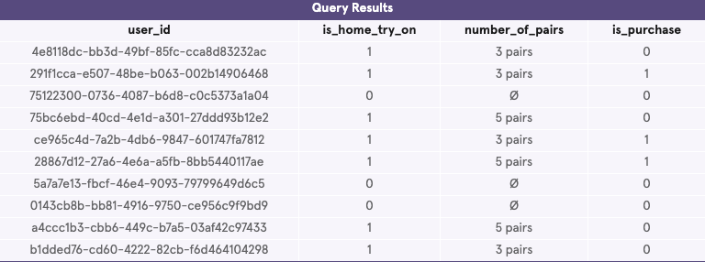
Query 5 – unique requirements
SELECT DISTINCT qu.user_id,
hto.user_id IS NOT NULL AS 'is_home_try_on',
hto.number_of_pairs,
pu.user_id IS NOT NULL AS 'is_purchase'
FROM quiz qu
LEFT JOIN home_try_on hto
ON qu.user_id = hto.user_id
LEFT JOIN purchase pu
ON pu.user_id = qu.user_id
LIMIT 10;
In this query, we select the user_id which is common in every table and we are checking if they have taken the ‘try at home’ option[1 or 0 for yes or no in the second column]
If they have opted for the try at home option, then how many pairs have they chosen[after left joining home_try_on with quiz, number of pairs for every user who has chosen try at home is selected from the joined table]
After trying the 3 or 5 pairs that they have taken home, we have found out whether they have purchased it or not[after left joining the joined table with purchase, if they have any entries in the purchase table, then they have completed the purchase]

Slide 14
Query 6 – Additional in-depth Analysis
Using the table generated in query – 5, there are a few insights which can be generated
Analysis on the basis of pairs taken home:
The users who did not take pairs home, did not buy any spectacles at the store
As shown in the graph, the users who took 5 pairs at home, had a higher chance of buying a pair of spectacles

Slide 15
Thank you! Do kindly provide feedback about any additional analysis that you want to see in my project. I’ll be updating this presentation with new insights once I get my hands dirty with this data.

